Slide 1






Web Technologies Development Project – Team 13

Slide 3
WELCOME

Slide 4
WELCOME

Slide 5
WELCOME
WELCOME

Slide 6
WELCOME

Slide 7
WELCOME

Slide 8
WELCOME
WELCOME

Slide 9
WELCOME

Slide 10
WELCOME

Slide 11
WELCOME

Slide 12
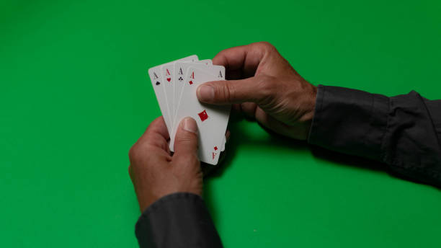
Card Game Interface
By Team 13

Slide 13
Card Game Interface
By Team 13

Slide 14
LINKEDIN
DAVINCI RESOLVE
Easy to code
3rd most popular language in the world
Top 15% programming professionals have python certification
57% of Job Seekers Use LinkedIn to Find New Job Opportunities
61 Million Users Look for Jobs Through LinkedIn Weekly
Over 58 Million Companies Are On LinkedIn
TTHIS IS Davinci Resolve
SFEGSHRHRH

Slide 15
FEATURES
LINKEDIN
DAVINCI RESOLVE
Easy to code
3rd most popular language in the world
Top 15% programming professionals have python certification
57% of Job Seekers Use LinkedIn to Find New Job Opportunities
61 Million Users Look for Jobs Through LinkedIn Weekly
Over 58 Million Companies Are On LinkedIn
TTHIS IS Davinci Resolve
SFEGSHRHRH

Slide 16
FEATURES
LINKEDIN
DAVINCI RESOLVE
Easy to code
3rd most popular language in the world
Top 15% programming professionals have python certification
57% of Job Seekers Use LinkedIn to Find New Job Opportunities
61 Million Users Look for Jobs Through LinkedIn Weekly
Over 58 Million Companies Are On LinkedIn
TTHIS IS Davinci Resolve
SFEGSHRHRH

Slide 17
FEATURES
Card Layout and Animation
User Interaction
Responsive Design
HTML: Create a card container structure using <div> elements to represent individual cards. Use nested <div> elements for the card's front and back, with appropriate classes or data attributes to identify each card's value and suit.
CSS: Apply CSS styles to these card elements, including card dimensions, borders, shadows, and background colors to simulate a realistic card appearance. Implement smooth animations, like transitions or keyframes, to create effects such as flipping a card when it's dealt or shuffling the deck.
HTML: Add interactive elements like buttons for actions such as shuffling the deck and dealing cards. Use <button> elements with appropriate labels and classes.
CSS: Apply CSS styles to these buttons, including hover effects, and possibly use CSS transitions or animations to make the buttons respond to user interactions with smooth and visually appealing effects
HTML: Structure the overall game interface using HTML elements that allow for responsive design, such as using a flexbox or grid layout to arrange cards and buttons. Utilize media queries to adapt the layout for various screen sizes and orientations.
CSS: Implement responsive CSS rules to ensure that the card game interface adapts gracefully to different screen sizes and devices. This may involve adjusting the card size, spacing, or button placement as the viewport size changes.

Slide 18
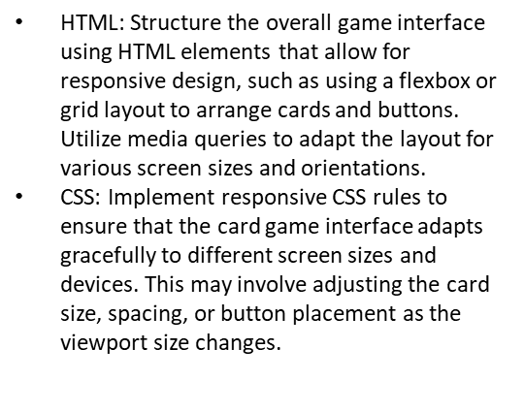
FEATURES
Card Layout and Animation
HTML: Add interactive elements like buttons for actions such as shuffling the deck and dealing cards. Use <button> elements with appropriate labels and classes.
CSS: Apply CSS styles to these buttons, including hover effects, and possibly use CSS transitions or animations to make the buttons respond to user interactions with smooth and visually appealing
Responsive Design
User Interaction
HTML: Create a card container structure using <div> elements to represent individual cards. Use nested <div> elements for the card's front and back, with appropriate classes or data attributes to identify each card's value and suit.
CSS: Apply CSS styles to these card elements, including card dimensions, borders, shadows, and background colors to simulate a realistic card appearance. Implement smooth animations, like transitions or keyframes, to create effects such as flipping a card when it's dealt or shuffling the deck.

Slide 19

FEATURES
Responsive Design
Card Layout and Animation
User Interaction
HTML: Create a card container structure using <div> elements to represent individual cards. Use nested <div> elements for the card's front and back, with appropriate classes or data attributes to identify each card's value and suit.
CSS: Apply CSS styles to these card elements, including card dimensions, borders, shadows, and background colors to simulate a realistic card appearance. Implement smooth animations, like transitions or keyframes, to create effects such as flipping a card when it's dealt or shuffling the deck
HTML: Structure the overall game interface using HTML elements that allow for responsive design, such as using a flexbox or grid layout to arrange cards and buttons. Utilize media queries to adapt the layout for various screen sizes and orientations.
CSS: Implement responsive CSS rules to ensure that the card game interface adapts gracefully to different screen sizes and devices. This may involve adjusting the card size, spacing, or button placement as the viewport size changes

Slide 20


